Slide 1
Code Abhyaas Basics -- 04

Slide 2
Asymptotic Analysis
We use time&space as measure in calculating the performance of an algorithm but we won’t measure them in exact numbers
We use mathematical models which helps in determining the time and space complexity
So Asymptotic analysis helps in evaluating performance of an algorithm in terms of input size and its increase and decrease of size

Slide 3
Asymptotic Notations
Asymptotic Notations are the mathematical tools used to describe the running time of an algorithm in terms of input size.
Ex: performance of car in highway, city & city+Highway.
Best Case → Omega Notation
Average Case → Theta Notation
Worst Case. → Big O Notation

Slide 4
Analysis and Rules to calculate Big O Notation.
If our device is a single processor
It performs sequential execution of statements.
Assignment operation takes 1 unit of time
Return statement takes in 1 unit of time
Arithmetical operation takes 1 unit of time
Logical operation takes 1 unit of time
Other small/single operations takes 1 unit of time
Drop lower order terms and constant multipliers(because we assume our input is very large)
Ex: T=n^2+3n+1 → O(n^2)
Ex: T=30+4 → O(1)

Slide 5
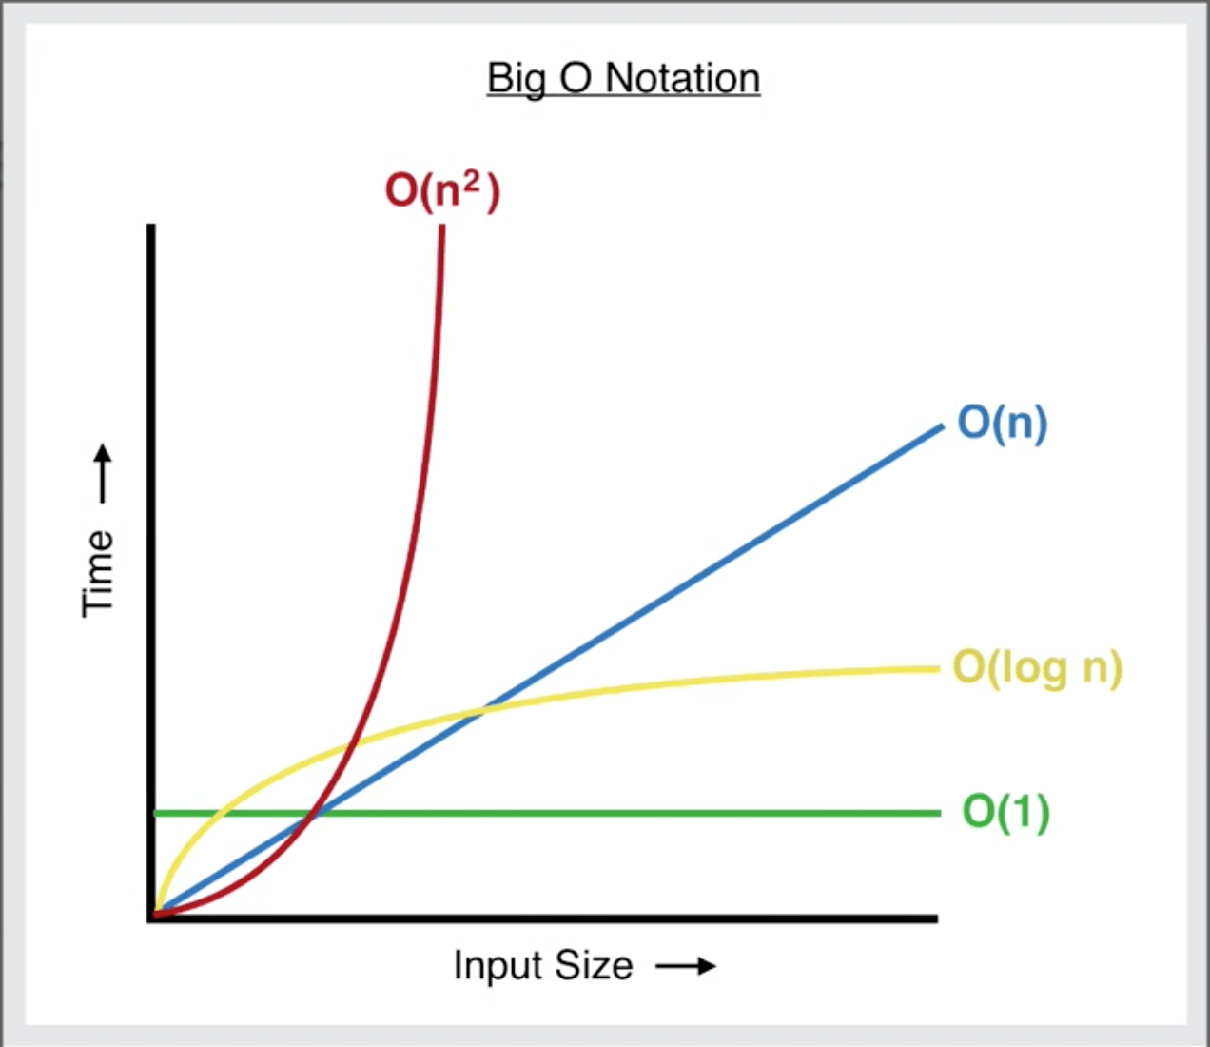

Slide 6
Example 1
Public int sum(int x,int y){
int result=x+y;
return result;
}

Slide 7
Example 2
for(i=1; i<=n; i++){
print(“Hi”);
}

Slide 8
Example 3
for(i=0; i<=n; i+=2){
print(“Hi”);
}

Slide 9
Example 4
for(i=1; i<=n; i*=2){
print(“Hi”);
}

Slide 10
Example 5
for(i=0; i*i<n; i++){
print(“Hi”);
}

Slide 11
Example 6
for(i=n; i>1; i/=2){
print(“Hi”);
}

Slide 12
Example 7
for(int i=2; i*i<10000; i++){
print(“Hi”);
}

Slide 13


